Slide 1

GOT STANDARD GRADES … NOW WHAT
A CLOSER LOOK AT WHAT COULD COME NEXT
Bob Cornacchioli
get2bobc@gmail.com
http://www.derotechnical.com

Slide 2

How long did it take?
ABCDEF to 4/3/2/1 or OSUN
Designing
Report Card
Curriculum Review
NEW Assessments
SPECIAL NEEDS
GIFTED
Grading Best
Practices
Comment
Narrative/Bank
Gradebook
Training
DATA ANALYSIS
Evaluation Student
Work Samples
TRANSITION TIME
12-24 months
Assignments/
Final Entry
ON-GOING PD
Communication
Plan
Professional
Judgement
Performance
Indicators
Standards
Selection
Paradigm
Shift PD
Why
Standards
WHERE ON THIS PATHWAY IS REVIEWING GRADES??

Slide 3

Standards Process – Should it stop? (GO LIVE and STOP!)
PS – Free PTP Metrics and Visual Aides
Reviewing Assignments and Scores
Differential Instruction and Assessment
Free Reports
Standard Grade Search Tool - Finding At Risk Students
Standards Grade % Breakdown
Assignments Tied to Standards
Count of Grades Given to a Standard
3 other FREE SIS Resources SQLReport 5 including
More than 1 Rollup Grade
Rollup Comments
PS- FEE Options
Target Audience – Admins/Curriculum Leaders
Agenda/Participants will be engaged in:
All PPT can be found @
www.derotechnical.com

Slide 4




CEO - DERO Technical Services (2007)
Marketing/- ParkBench Software Trainer (2007)
Evangelist/Process Lead- Level Data (2010)
PSISJS Partner – Standards/Trainer (2013)
Alpha/Beta Team for PS and PTP
Bob Cornacchioli
Director of Technology and Media Services
Shrewsbury Public Schools (16 yrs.)
PowerSchool Administrator (6 yrs.)

Slide 5



What’s your role in the district?
How long have you grading standards?
Do you recall the transition process from traditional to standards grades?

Slide 6

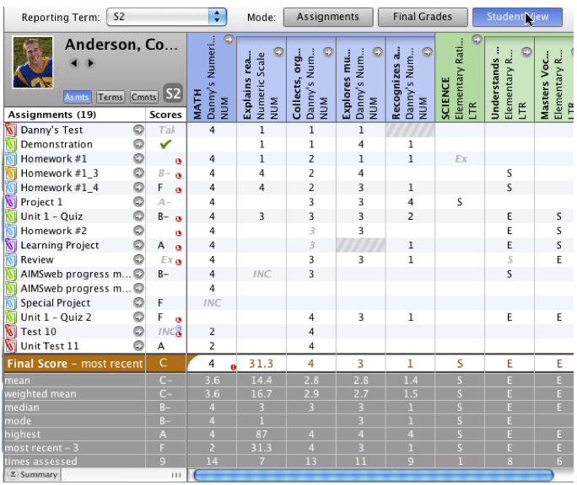

Matrix vs. Metrics
PTG – Student View

Slide 7
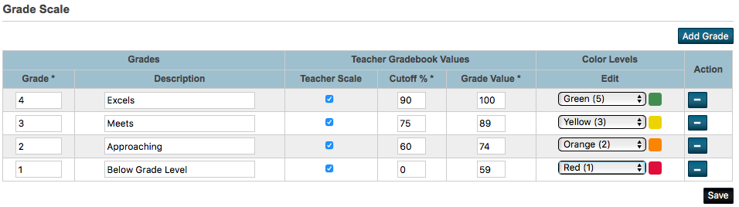
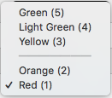
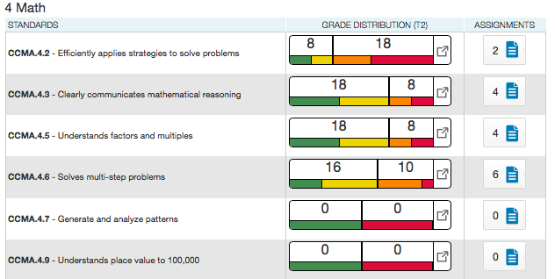
Grade Scales/Standard Progress

Slide 8
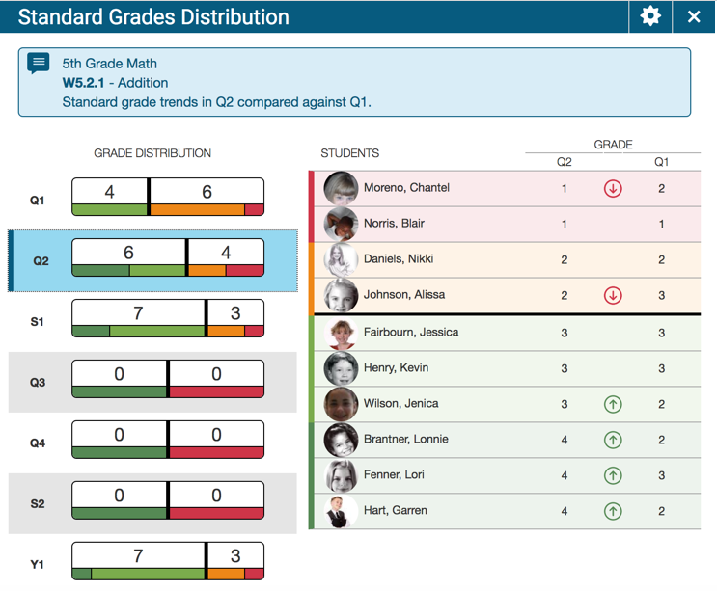


Standard Progress & Trend Comparison

Slide 9

Differentiated Instruction/Salad
(Instruction and Assessment)
One-size-fits-all as it applies to teaching will bore some and baffle others. Differentiating instruction is the key to reaching all students.
Richer mix of high-quality assessments formats can reduce the overall burden of assessment for teachers and is better for students.
Measure less, but measure it better!
Race, P. - UK Centre for Bioscience Briefing on Assessment.
How often are your assessments discussed/reviewed?

Slide 10
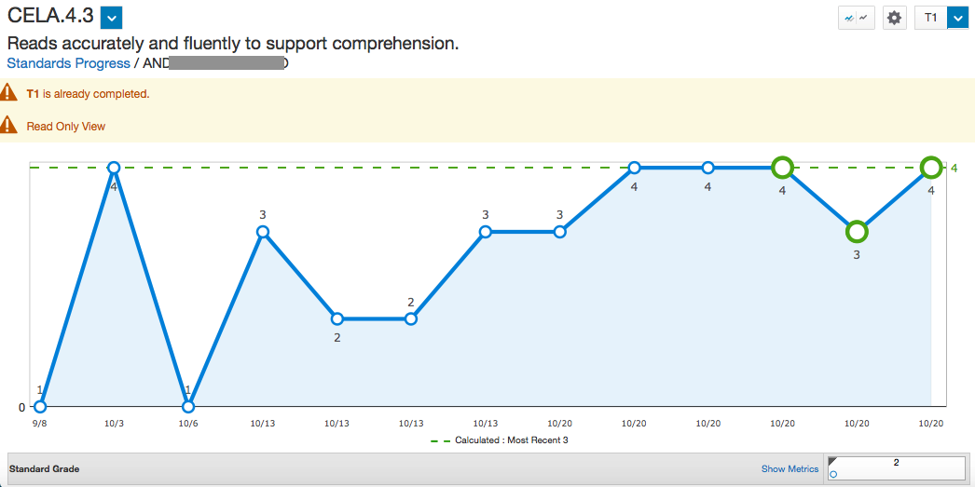
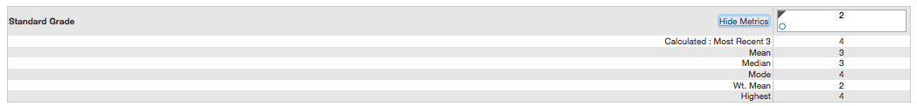
Individual Student Progress (3 clicks)
Frequency of Assessment – Have you discussed this?
Evidence > Frequency vs Mode, Median, Mode

Slide 11
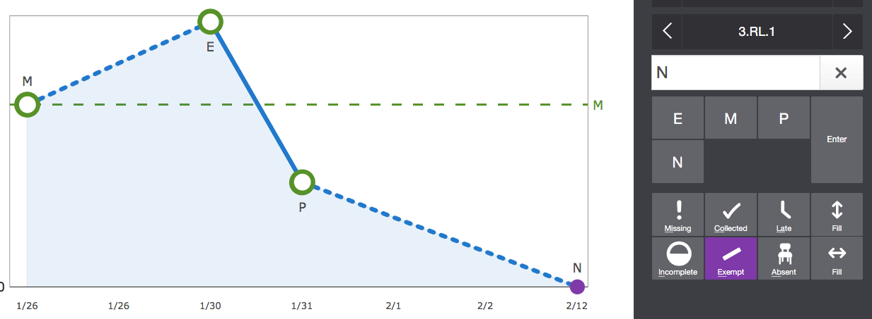
Exemption Policy – “Yours”
Why would a teacher possible EXEMPT a particular score for a given student?
Have you discussed this?

Slide 12
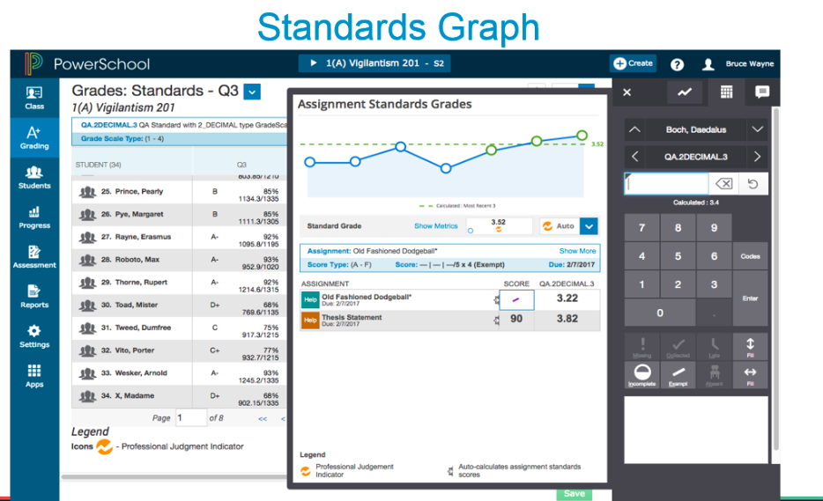
EVEN SIMPLIER w PS V 11.0.4.1 (Jan)

Slide 13
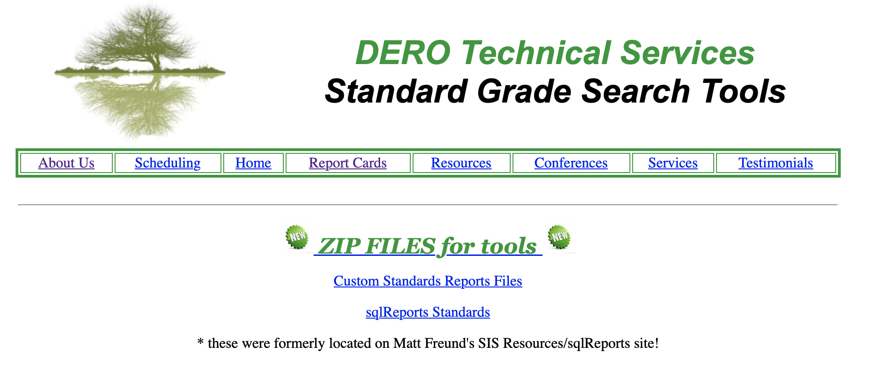
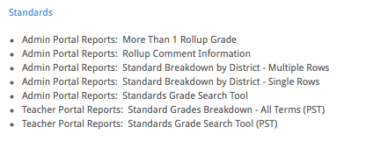
Free Reports with Matt Freund
http://www.derotechnical.com/STANDARDS/SGST.html

Slide 14
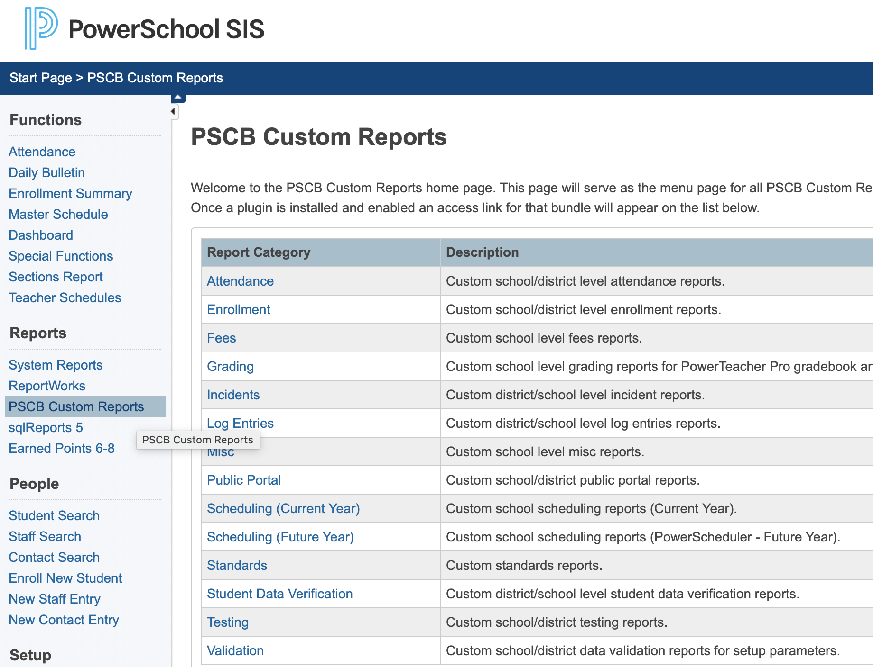

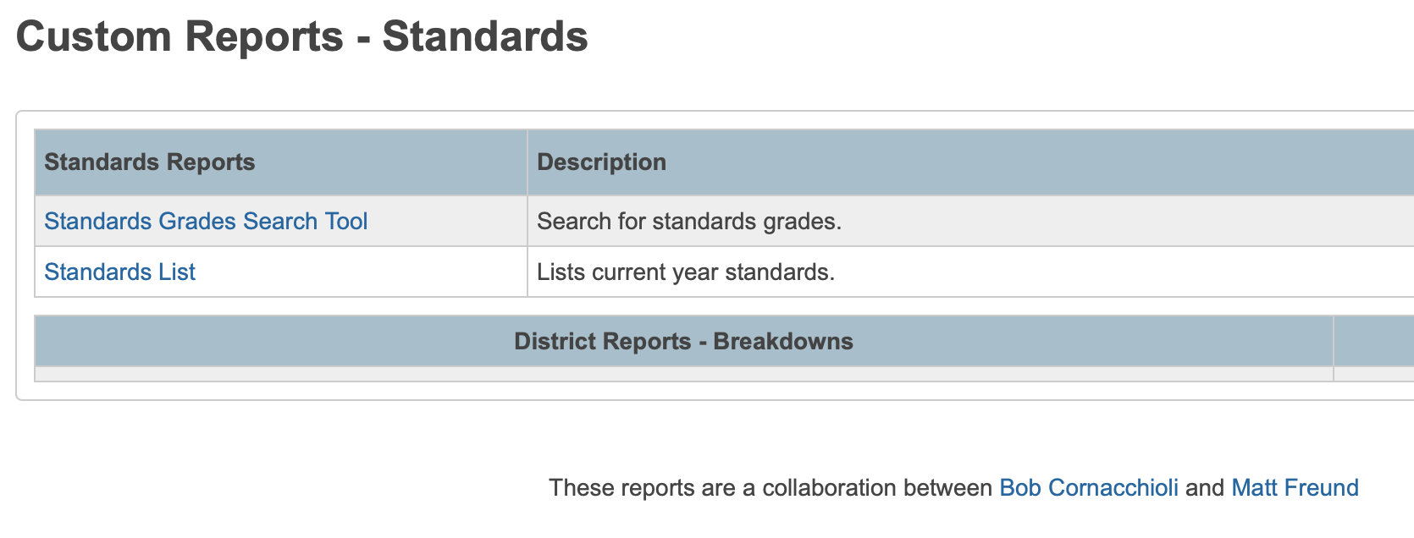
Great News- FREE PSCB Bundle
PSCB is a collaboration of Rob Staats, Manjit Barsa and Michael Moore – Each of these contributors has over 15 years in developing PS custom pages and reports
https://www.powerdatasolutions.org
More STANDARDS reports – including all of our free reports will be coming soon!

Slide 15

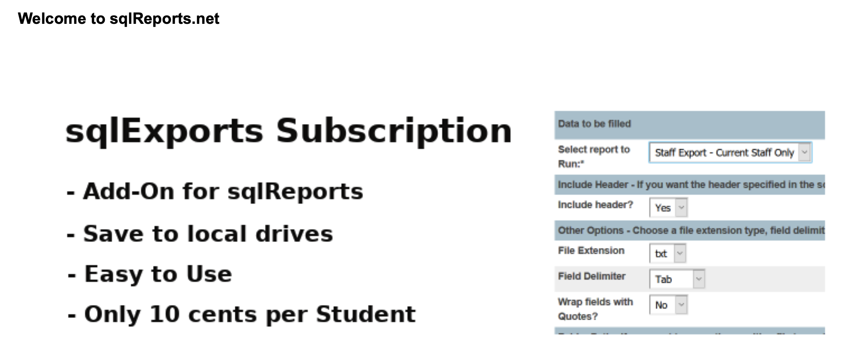
- Renewal only 5 cents per Student
Premium Reports - access to 250+ reports at this site, plus any new ones, for one year
Premium Downloads - access to sqlReports downloads and miscellaneous downloads for one year, including:
  sqlReports Premium and site subscription versions of sqlReports 6.x
  sqlReports Add-Ons: sqlExports Premium / sqlReports Q / Saved Params
  Miscellaneous Downloads: sqlFormLetters / Custom Links / Student Contacts Mailing Labels
Premium Support - access to 30+ Knowledgebase articles for one year

Slide 16


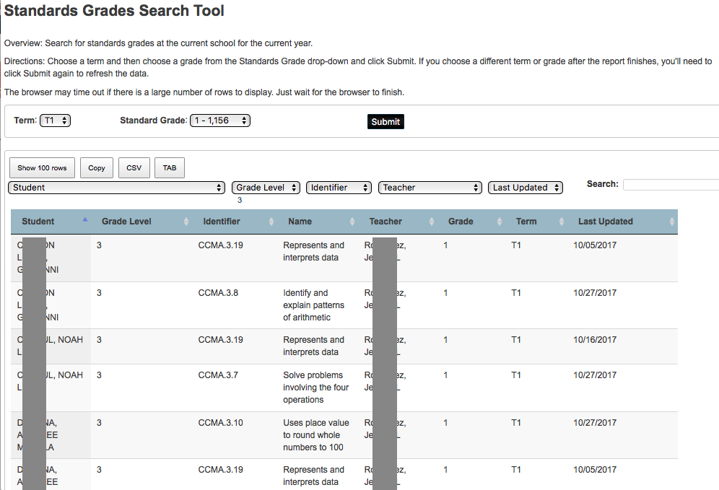
FAST FIND – STUDENTS WITH LOW GRADES
Are there more indicators than grades
that could put a student at risk

Slide 17

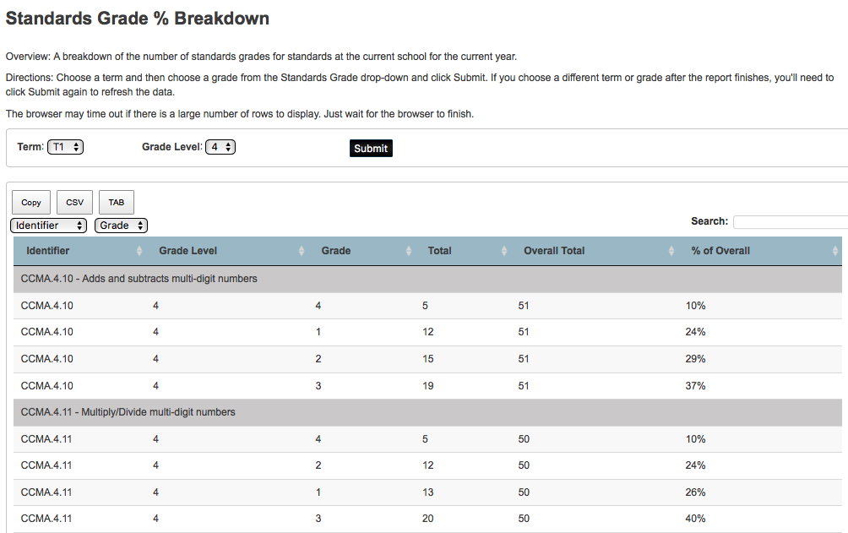
How are your teachers grading?
Multiple schools with one search - We got that!

Slide 18

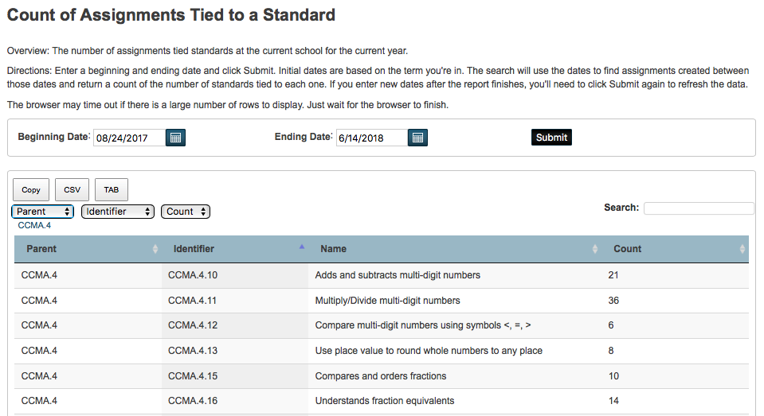
Are your teachers using assignments

Slide 19

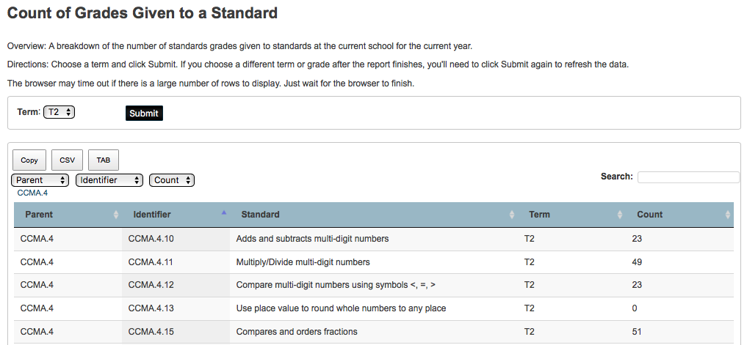
Custom Standards Report – Assignments
NOT ALL STANDARDS ARE CREATED EQUAL

Slide 20
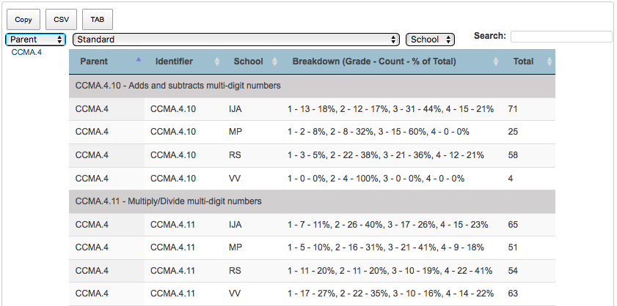
LET THE COMPARISON BEGIN - Standard by District – Single Rows
PLEASE NOTE – You should upgrade to SQLReports 5 to avoid
Cross Scripting Error

Slide 21






PowerTeacherPro and TRANSFERS
In the same term
Teacher 1 – scores Johnny in a variety of assignments and standards.
John’s scores are stored in Teacher 1 sections
John transfers out of Teacher 1’s sections – into Teacher 2 sections (doesn’t matter if it’s the same school or another school in Lawrence)
Teacher 2 CAN SEE John’s previous section grades – so Teacher 2 scores the same standards that Teacher 1 did.
PowerSchool inconsistently averages those scores BUT….

Slide 22
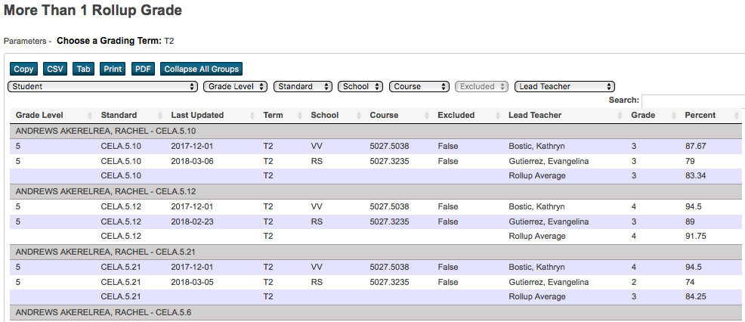
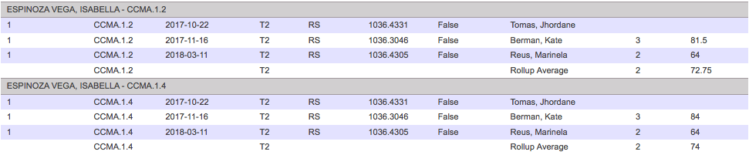
Grading the same standard twice in the same term

Slide 23
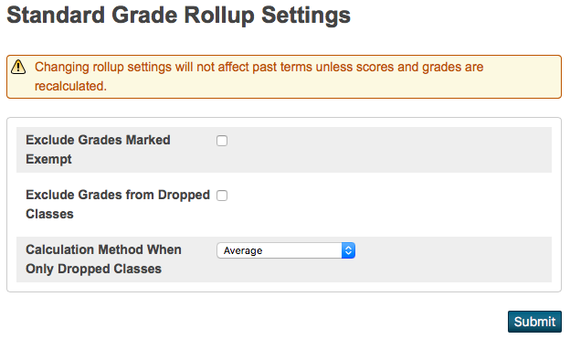
Once on PS 12.0.X
√
If checked, any grades a teacher marked exempt are not included in the standard grade rollup.
√
If checked, any grades from classes the student has dropped will not be included in the standard grade rollup unless there are no active grades. In the case of no active grades, grades from dropped classes are included.
When there are grades only from dropped classes, the district has the option to report the average of all dropped grades, or just the grade from the most recently enrolled class. Use the Calculation Method When Only Dropped Classes menu to choose whether to average the grades or to use Most Recent Enrolled only the last grade.

Slide 24

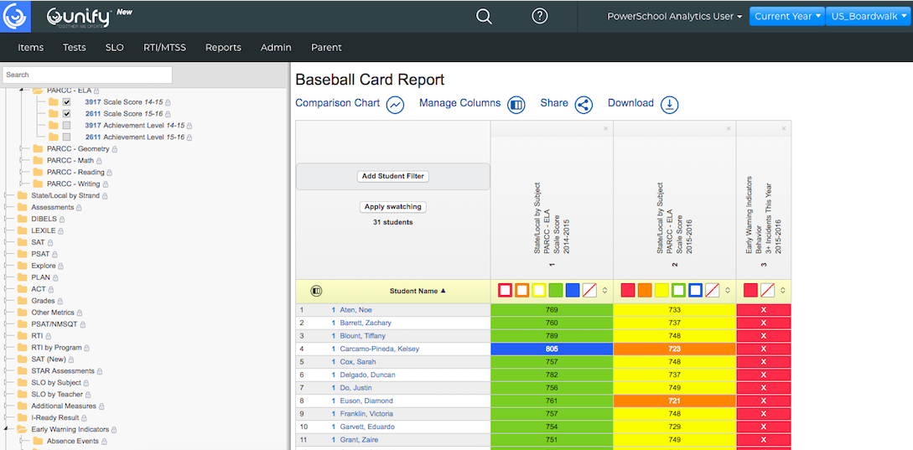
$ What can PowerSchool Offer $
Performance Matters Analytics.
$2.50/kid with great promos available through December.

Slide 25
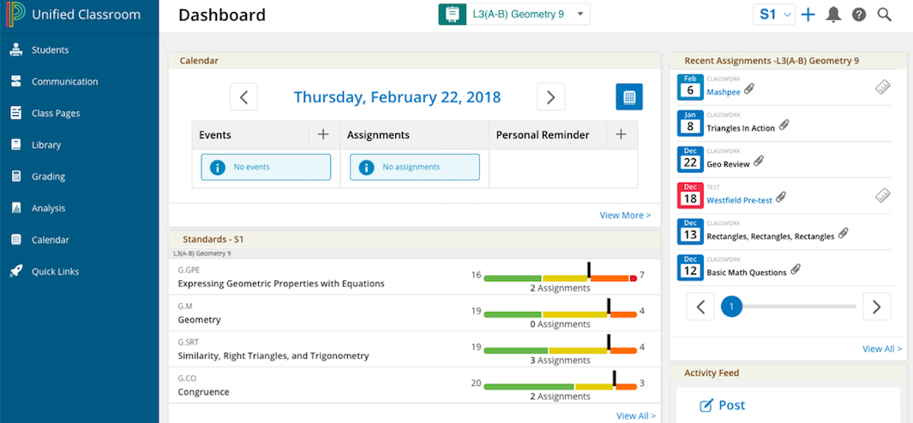
Unified Classroom w/ PTP Links - $ FEE

Slide 26

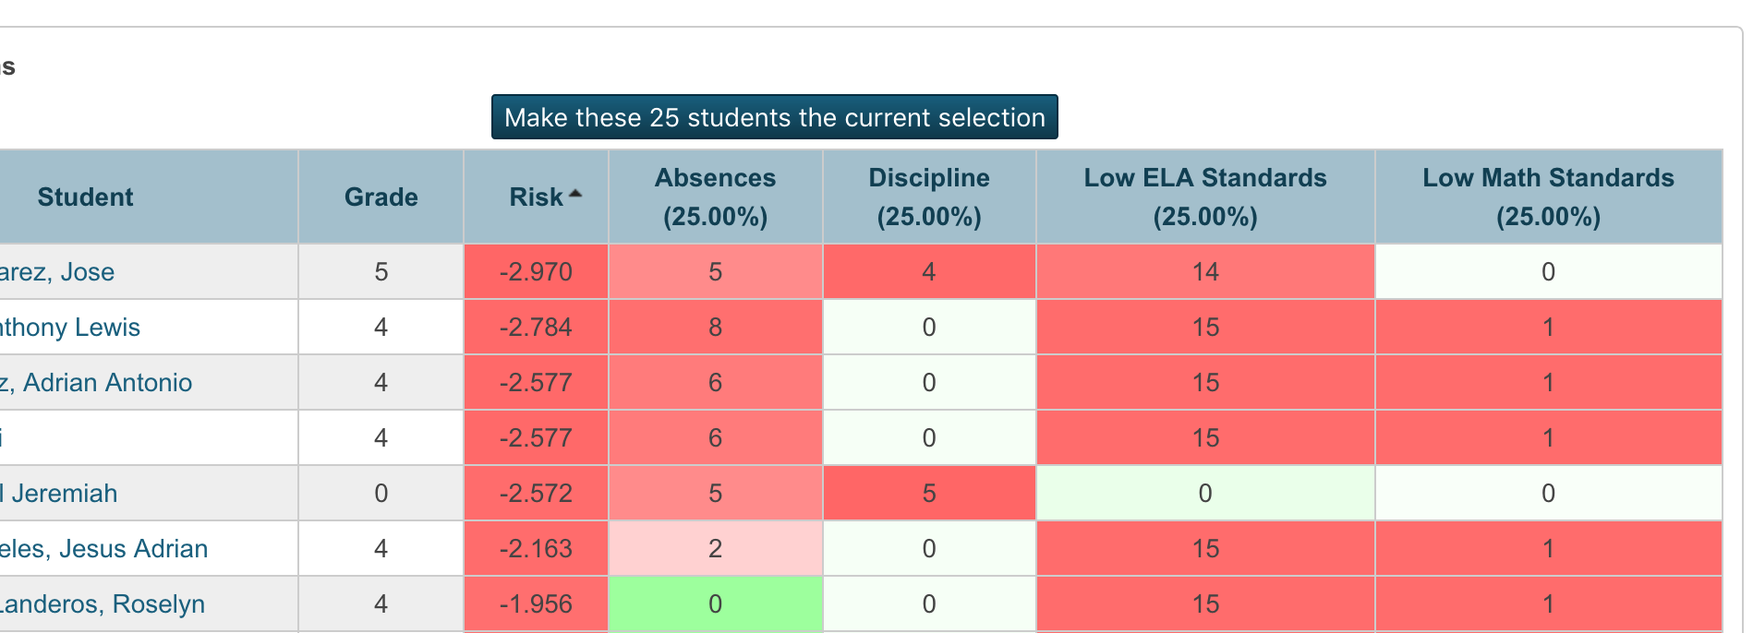
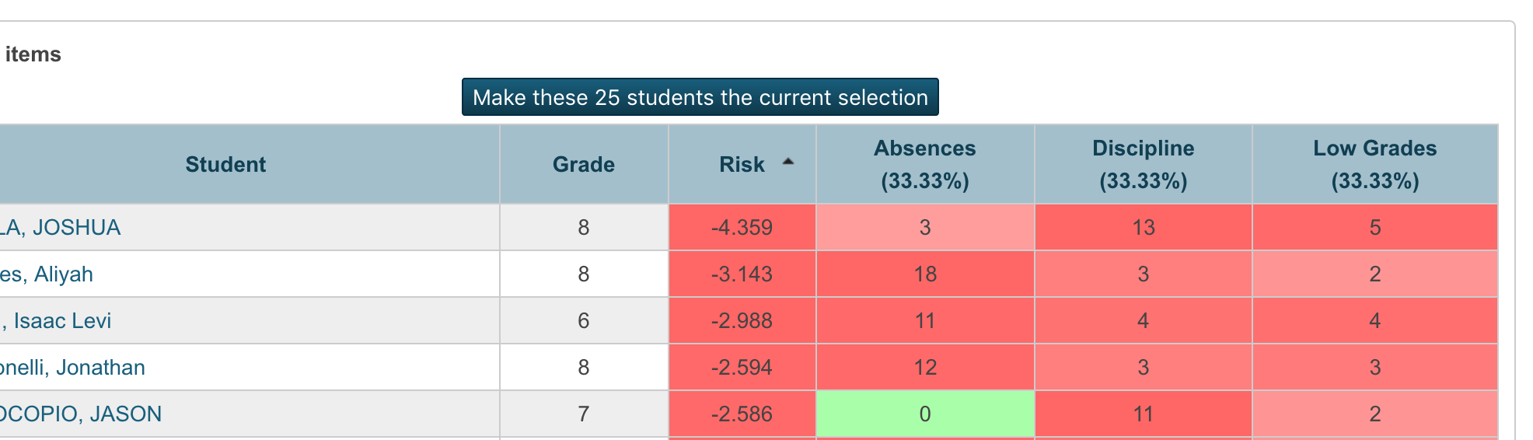
(grades-attendance-discipline-assignments-dismissals-nurse visits-community service, ETC)
$1 PER Student
Demo – get2bobc@gmail.com
Completely customizable - your indicators/schools!
13 Mins - https://www.youtube.com/watch?v=f_KZE1dH7pA&feature=youtu.be

Slide 27
ANY AND ALL DERO RESOURCES ARE AVAILABLE
TO DOWNLOAD, TWEAK and USE FOR YOUR DISTRICT!
Q & A
Bob Cornacchioli
get2bobc@gmail.com
www.derotechnical.com

